Slide 1

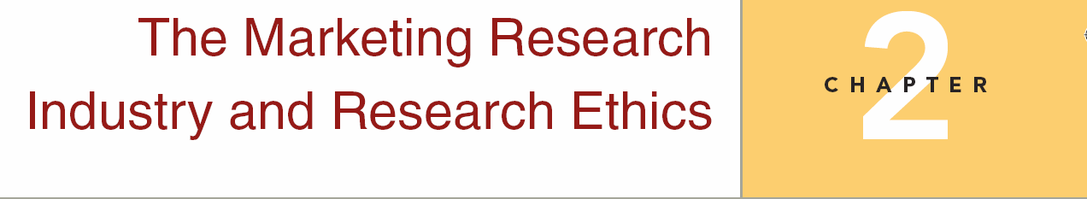
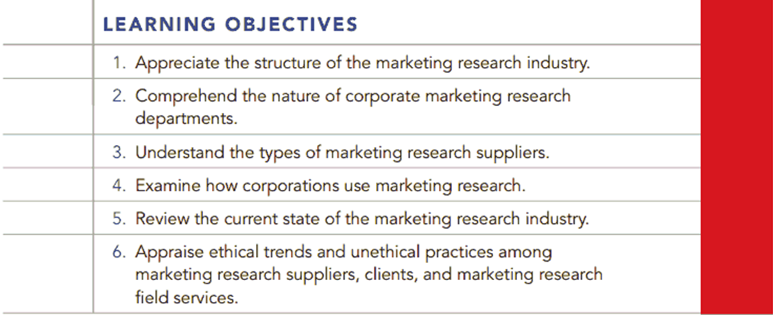
Chapter Two

Slide 2
Question
Read Case 2.2 – Coke Juices Up a Market Test (P.44)
Were Coke’s attempts to fix the market test unethical? If so, was Coke guilty of unethical behavior, or was it just the fault of some misguided employees?

Slide 3
Question
2. Burger King is Coke’s second largest fountain drink customer after McDonald’s. The Richmond test started out very poorly, and it was clear that unless results improved, the national Frozen Coke promotion was not going to happen. Coke was worried that without the promotion it would not make its fountain sales objectives for the year. At that point, it was decided to stimulate value-meal sales in Richmond. Did the desired end (meeting sales goals) justify the actions taken? Why or why not?

Slide 4
Question
3. Should Coke fire those responsible, counsel them, or do nothing?

Slide 5
Answer
Case 2.2 – Coke Juices Up a Market Test (P.44)
1. It depends upon the purpose of the market test. If the purpose is to gather sample data as an estimate of what market sales would be for the drinks, then the test is biased and the results are tainted. If the purpose is to induce behavior so that respondents can give feedback concerning a specific product, then the inducement is appropriate. Generally, market tests are conducted to gauge market potential for a product or service, hence, Coke was “juicing” the test results.

Slide 6
Answer
Case 2.2 – Coke Juices Up a Market Test (P.44)
2. The problem with such inducements is that they artificially stimulate demand, thereby biasing the results with abnormal market behavior. Hence, the artificial stimulation of demand biased the results, and cannot be justified.
3. The intent to distort data that has the kind of financial implications associated with the market test would probably call for the firing of those responsible.

Slide 7
Question
A custom ad hoc research firm is attempting to develop a template for measuring community assessment, that it can market and administer communities in general. It decides to construct a relatively comprehensive questionnaire with the goal of determining which questions are the most important generally in a community assessment. Who would the research firm want to sample for such a study and who would provide the sample frame?

Slide 8
Answer
There are a number of possible answers here. One possible suggestion would be finding a sampling firm that would provide a national sample of respondents. Probably doing the survey online would be the most efficient approach, and utilizing a research panel from a sampling firm that would guarantee a certain number of usable responses for a reasonable price per usable response.

Slide 9
Question
Where are the majority of the large global marketing research firms based?
a. Japan
b. Canada
c. France
d. Germany
e. United States

Slide 10
Answer
E

Slide 11
Question
In survey research, it is especially important to protect respondents’_______.
a. responses
b. integrity
c. professionalism
d. anonymity
e. none of these

Slide 12
Answer
Ans: D

Slide 13
Question
The idea that a person performs the act that benefits the most people, regardless of personal feelings or the societal constraints such as laws is most closely related to which ethical theory?
Act utilitarianism
Rule utilitarianism
Casuist
Act deontology
Rule deontology

Slide 14
Answer
Ans: A

Slide 15
Question
The major ethical theories discussed in the chapter include all of the following except:
Existentialism
Utilitarianism
Deontology
Casuist

Slide 16
Answer
Ans: A

